Slide 1
AT Tool In-service Presentation
Romelia Hodges
Week 6
EDUT 521

Slide 2
Kuzweil 3000 Reading Support
Muti-Senory support system promotes effective and efficient reading skills.
Multi Senroy word processing for real and well-organized implementation of the writing process
Multi Sensory graphic organizer promotes active visual organization of views
Can be found and purchased through Kurzweil Education with 30 day free trial
https://www.kurzweiledu.com/products/reading.html

Slide 3
Student Profile
This AT is avail for all students and adult learners and can be purchased by the school district as a suit to increase reading proficiency. However studies have show that it works well for student with disabilities as well because it can be tailored to their specific needs.
Student with Learning Disabilities
ADD/ADHD
Cognitive Impairments
Visual Impairment
ESL Students

Slide 4
How can it Help?
Coverts text to speech so that students have a better comprehension and retention of word, sentence and paragraph. Converts to word and assist in the editing process.
Highlight the words spoke for interactive visual tracking which leads to better focus and attention to detail.
Help students to become independent learners and reach full academic potential.
Supports for reading, note taking and chapter summarizing
Also includes graphic organizer for brainstorming 12,000 graphics for word association for over 40,000 words

Slide 5
Improvements
While the Kurzwil 3000 6.0 went under a tremendous overhaul and has been touted as one of most powerful learning tools on the market today, it memory is slow.
Sometimes the highlighting lags behind the voice recognition.
So as a workaround it is easier to enter the program through a saved document than putting the demand on the memory. This can be slightly frustrating for student with attention issues and should be addressed in an update.

Slide 6
Value
I like this tool so much after researching it value I downloaded the free 30 day trial for my students.
I was impressed by the format and blown away by the vast content and study material.
There is nothing I did not like about this AT tool.

Slide 7
Patrick
ADHD student with learning disabilities
Uses AT to navigate through the page with highlighted text and specific word
Searches by specific page similar to regular book
Is able to increase reading speed between 50 to 400wpm to suit his reading ability
Uses AT to look up unknown words for definition, spelling and sound with syllable break down.
Uses AT for notetaking while reading (interaction keeps students attention)
Highlights in different colors his notes importing notes directly from text.

Slide 8
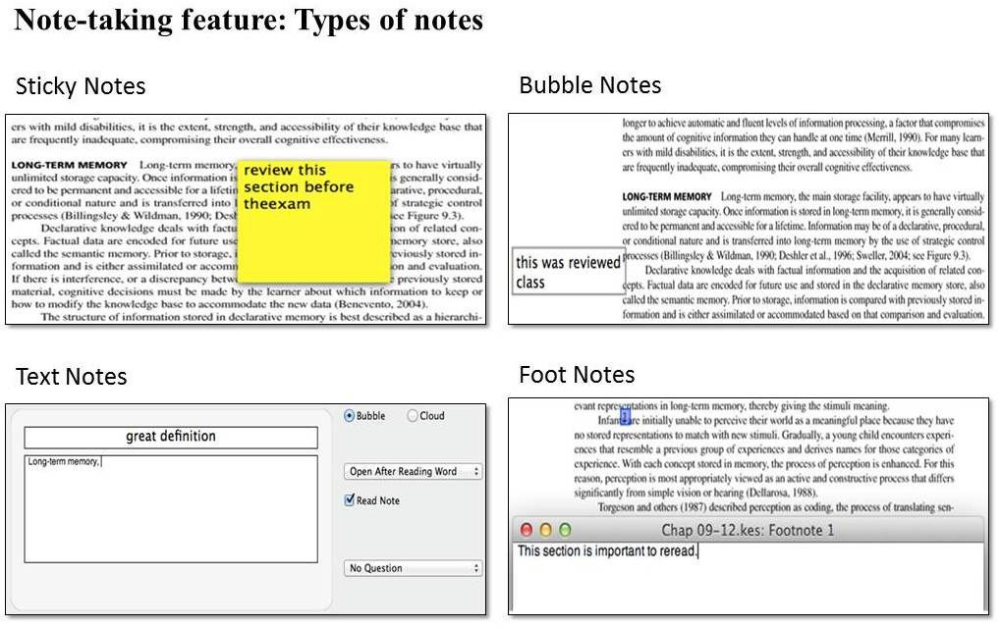
Sample of Student Work (Hypothetical)

Slide 9
Kurzweil for all
Kurzweil can be used in post secondary education and secondary education by any individual who needs reading assistance, lacks good study habits, or needs organizational compliment.
It caters to the needs of each student regardless of LD, SN or EL.

Slide 10
References
Hecker, L., Burns, L., Elkind, J., Elkind, K., & Katz, L. (2002). Benefits of assistive reading software for students with attention disorders. Annals of Dyslexia, 52.
Kurzweil Educational Systems. (2004). Scientifically-based research validating Kurzweil 3000: An annotated review of current research supporting the use of Kurzweil 3000 in the classroom. Bedford, MA.
Ochoa, T., Kelly, M, Londergan, M., (2004) Kurzweil 3000 as a tool to improve self-concept, fluency, and comprehension skills in students with reading-related disabilities or at-risk for reading problems.

